Slide 1




BUSINESS COMMUNICATION
VR
Impact of
On Education
Saanuj
Saksham
Saksham Chauhan
Sakshi Shah
Saurabh Sharma

Slide 2
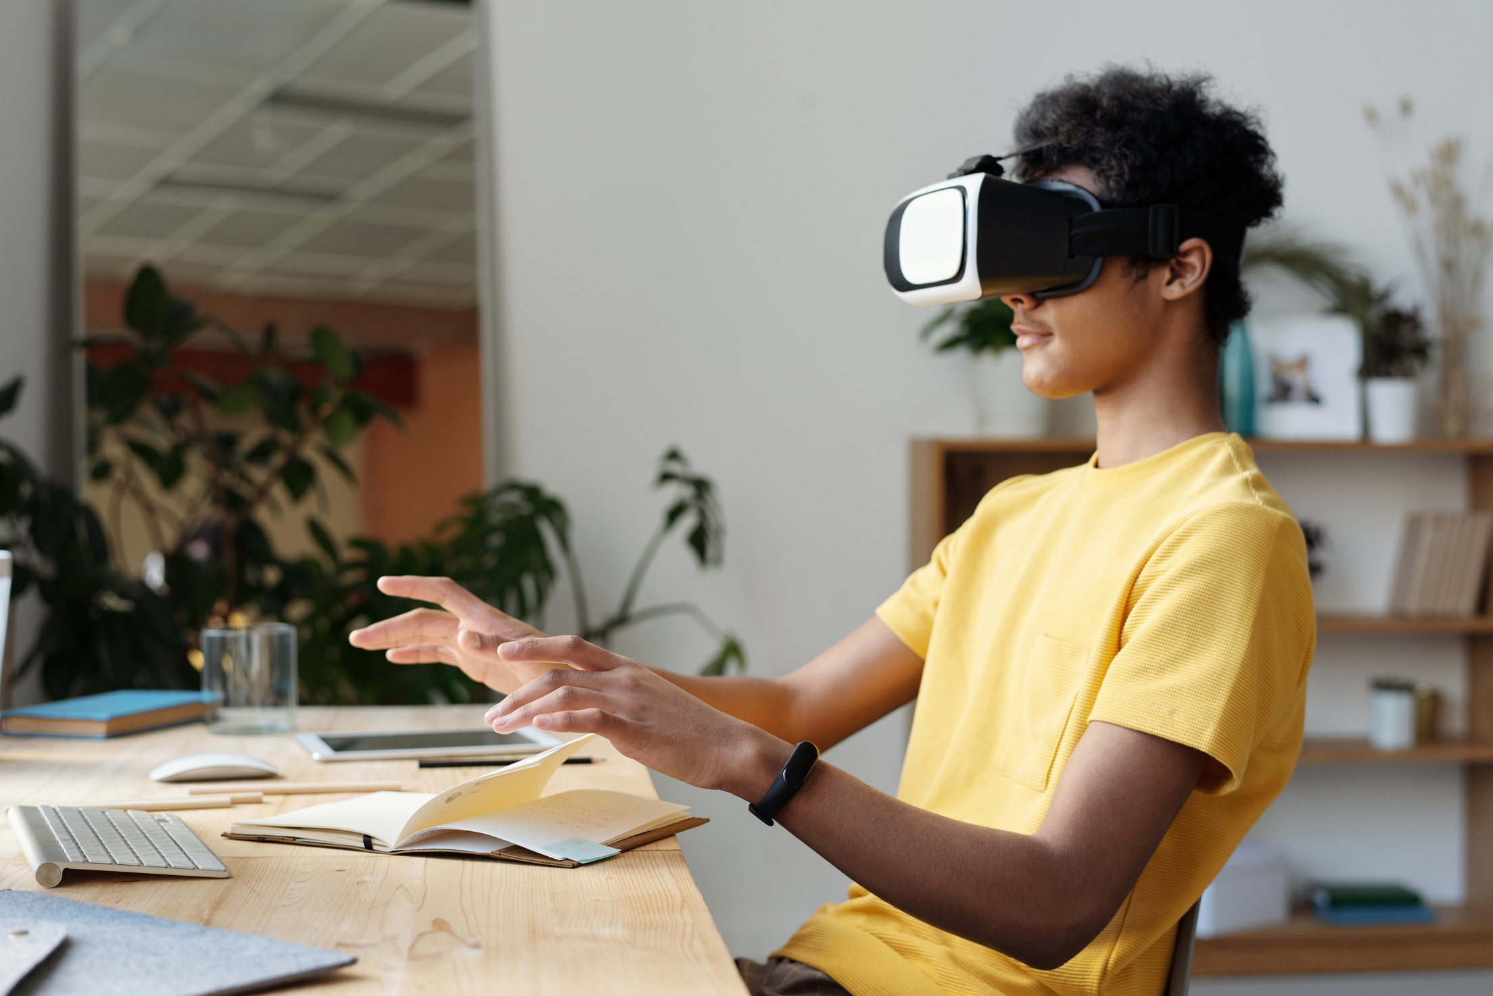
What Do You Know
About VR?
Virtual reality (VR) is a simulated experience that employs pose tracking and 3D near-eye displays to give the user an immersive feel of a virtual world.
Applications of virtual reality include entertainment (particularly video games), education (such as medical or military training) and business (such as virtual meetings).

Slide 3
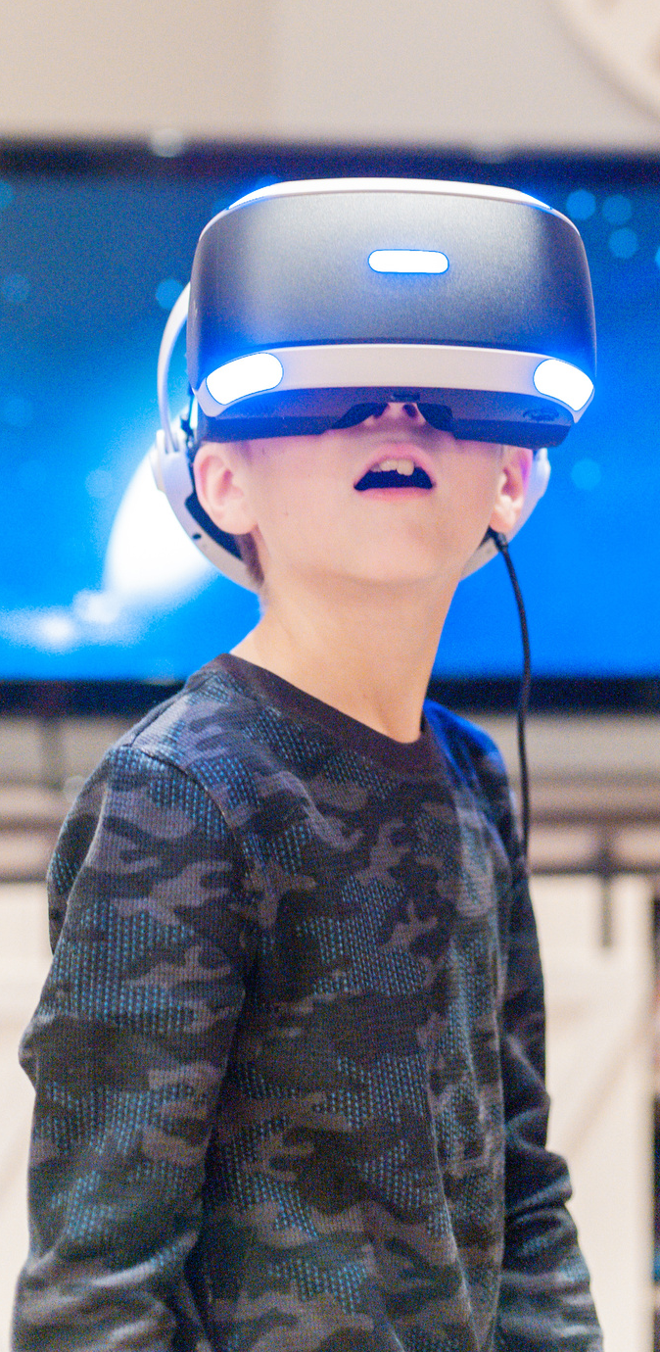

Evolution
OF VR
Technology In 1939
Technology In 1991
It's been a long time coming, but it's definitely been worth the wait. To give you an idea of how far VR has come, here's a quick trip through the leading VR systems over the years.
Technology In 1993
Technology In 1995
Technology In 2016-2022

Slide 4
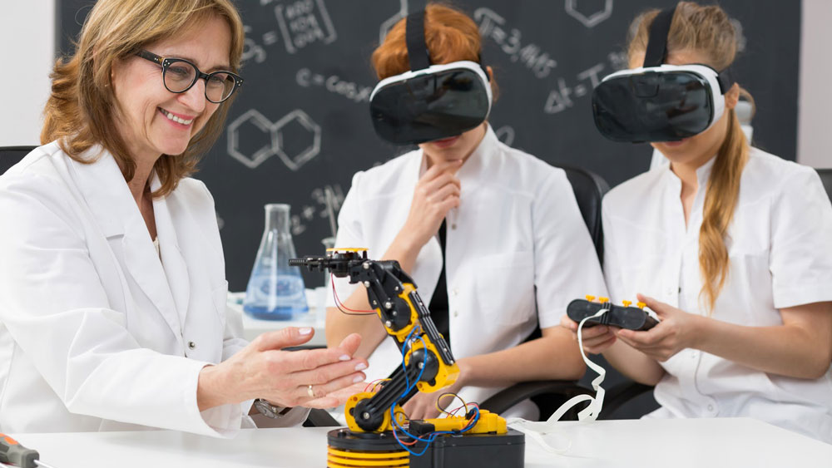
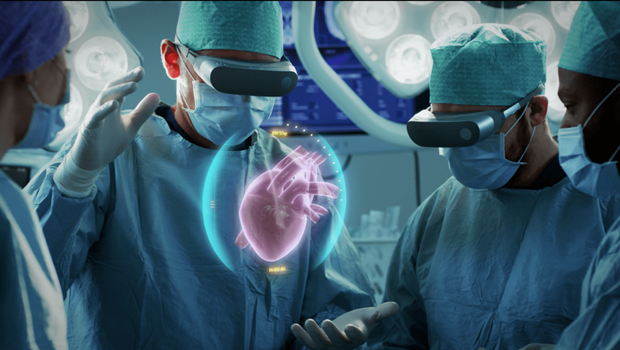
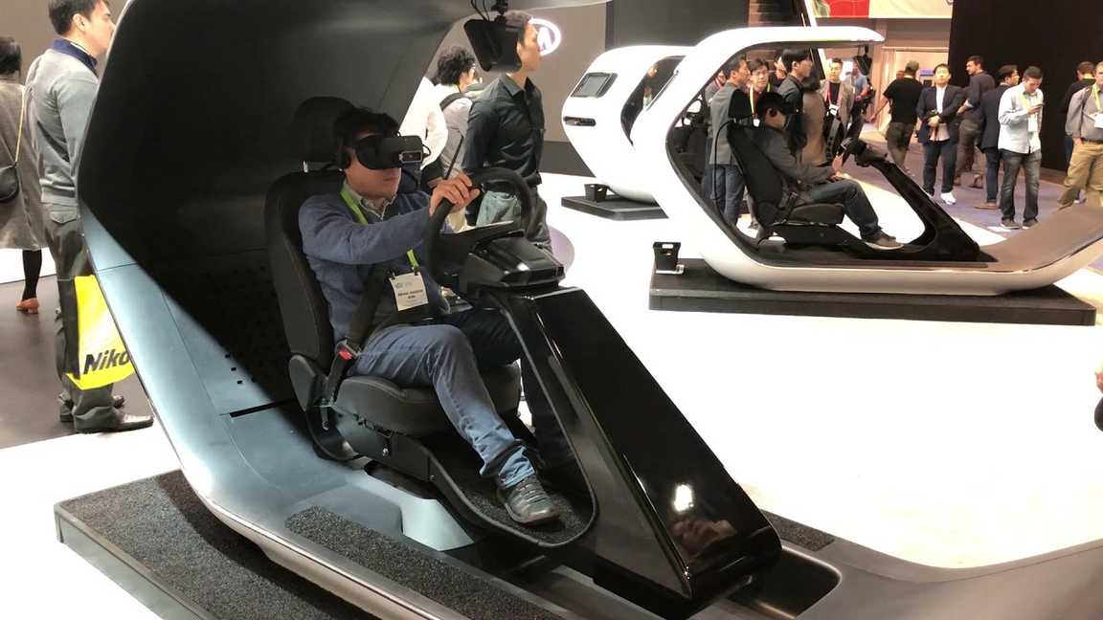
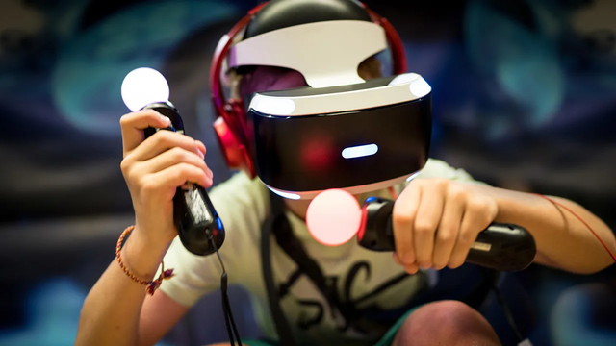
Applications Of
Virtual Reality

Slide 5
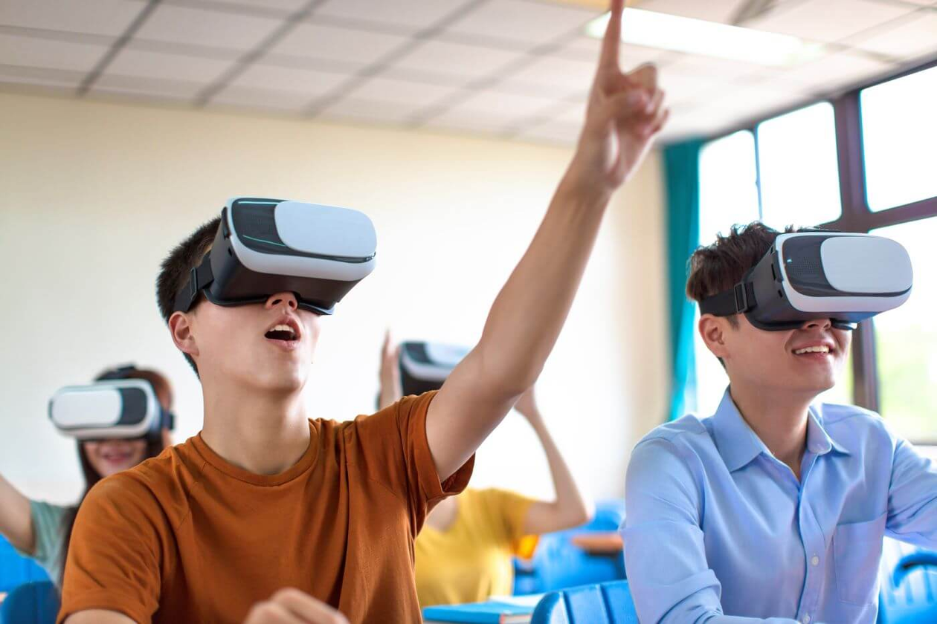
VR in Education
The days of learning being restricted solely to reading textbooks and listening to boring lectures are numbered.

Slide 6
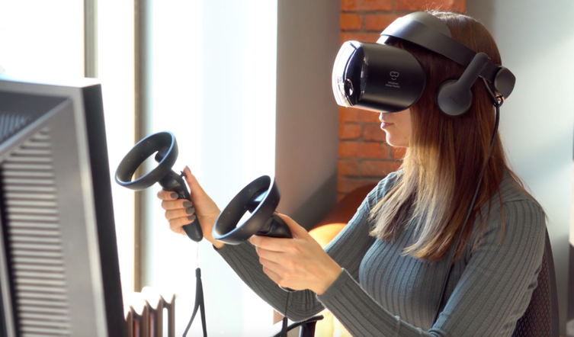
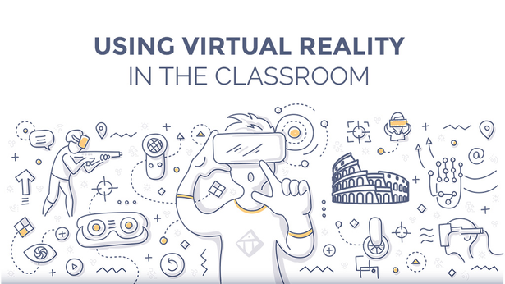
Benefits Of VR in Education
VR creates an entire digital environment, a 360-degree, immersive user experience that feels real. In a VR setting, students can interact with what they see as if they were really there.

Slide 7
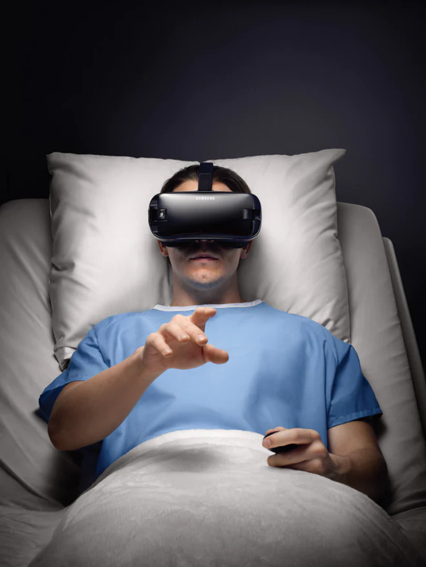


Disadvantages Of VR
Many more ....

Slide 8


Conclusion
By adding a new dimension to the learning experience, virtual reality can revolutionize education across every level. We are currently only seeing the early stages of an educational paradigm shift being created by virtual technology.

Slide 9

THANK YOU

